Slide 1
What is Amazon EC2?
Amazon EC2 is a virtual computing environment
Elastic
Completely Controlled
Flexible
For use with other Amazon Web Services
Reliable
Secure
Notes:
Service Highlights
Elastic – Amazon EC2 enables you to increase or decrease capacity within minutes, not hours or days. You can commission one, hundreds or even thousands of server instances simultaneously. Of course, because this is all controlled with web service APIs, your application can automatically scale itself up and down depending on its needs.
Completely Controlled – You have complete control of your instances. You have root access to each one, and you can interact with them as you would any machine. You can stop your instance while retaining the data on your boot partition and then subsequently restart the same instance using web service APIs. Instances can be rebooted remotely using web service APIs. You also have access to console output of your instances.
Flexible – You have the choice of multiple instance types, operating systems, and software packages. Amazon EC2 allows you to select a configuration of memory, CPU, instance storage, and the boot partition size that is optimal for your choice of operating system and application. For example, your choice of operating systems includes numerous Linux distributions, Microsoft Windows Server and Open Solaris.
Reliable – Amazon EC2 offers a highly reliable environment where replacement instances can be rapidly and predictably commissioned. The service runs within Amazon’s proven network infrastructure and datacenters. The Amazon EC2 Service Level Agreement commitment is 99.95% availability for each Amazon EC2 Region.
Secure – Amazon EC2 provides numerous mechanisms for securing your compute resources. Amazon EC2 includes web service interfaces to configure firewall settings that control network access to and between groups of instances.
When launching Amazon EC2 resources within Amazon Virtual Private Cloud (Amazon VPC), you can isolate your compute instances by specifying the IP range you wish to use, and connect to your existing IT infrastructure using industry-standard encrypted IPsec VPN.
For more information on Amazon EC2 security refer to our Amazon Web Services: Overview of Security Process document.
Inexpensive – Amazon EC2 passes on to you the financial benefits of Amazon’s scale. You pay a very low rate for the compute capacity you actually consume. See Amazon EC2 Instance Purchasing Options for a more detailed description. On-Demand Instances – On-Demand Instances let you pay for compute capacity by the hour with no long-term commitments. This frees you from the costs and complexities of planning, purchasing, and maintaining hardware and transforms what are commonly large fixed costs into much smaller variable costs. On-Demand Instances also remove the need to buy “safety net” capacity to handle periodic traffic spikes.
Reserved Instances – Reserved Instances give you the option to make a low, one-time payment for each instance you want to reserve and in turn receive a significant discount on the hourly usage charge for that instance. After the one-time payment for an instance, that instance is reserved for you, and you have no further obligation; you may choose to run that instance for the discounted usage rate for the duration of your term, or when you do not use the instance, you will not pay usage charges on it.
Spot Instances – Spot Instances allow customers to bid on unused Amazon EC2 capacity and run those instances for as long as their bid exceeds the current Spot Price. The Spot Price changes periodically based on supply and demand, and customers whose bids meet or exceed it gain access to the available Spot Instances. If you have flexibility in when your applications can run, Spot Instances can significantly lower your Amazon EC2 costs. See here for more details on Spot Instances.

Slide 2
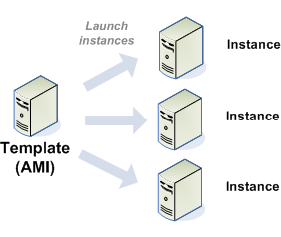
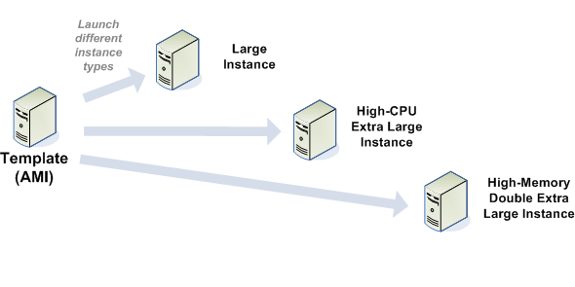
What is an AMI?
Notes:
Instance store-backed and EBS-backed
EBS-backed AMI: EBS volume created from EBS snapshot (in S3) and attached as root device
Instance store AMIs can not be stopped: only running, rebooting or terminated
EBS-backed AMIs boot faster
An Amazon Machine Image (AMI) contains all information necessary to boot instances of your software. For example, an AMI might contain all the software to act as a web server (e.g., Linux, Apache, and your web site) or it might contain all the software to act as a Hadoop node (e.g., Linux, Hadoop, and a custom application). You launch one or more instances of an AMI. An instance might be one web server within a web server cluster or one Hadoop node.
Amazon AMIs
Third-party AMIs

Slide 3
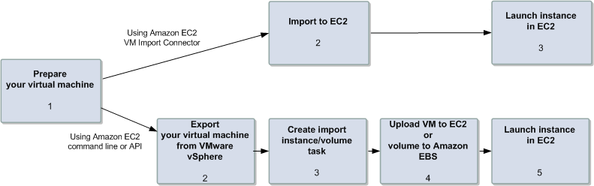
How to create an AMI?
Notes:
EBS backed
S3 backed
Imported
Re-bundled

Slide 4
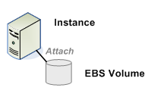
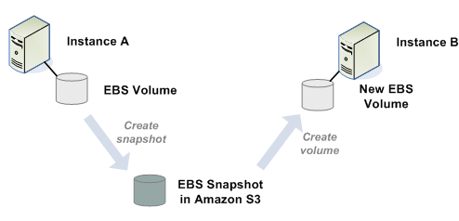
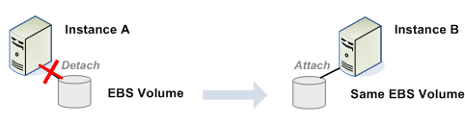
What is an EBS volume?
Notes:
1GB to 1TB
Raw, unformatted block devices
Exist in one AZ, replicated in that AZ
Point-in-time snapshots; persisted in S3
Cloud Watch metrics (latency, bandwidth, throughput, queue depth)
Latency and throughput designed to perform better than EC2 instance stores in almost all cases
More frequent snapshots increase durability of volume
Charged per GB allocated and $.10 per 1 million I/O requests
Summary
EBS provides block level storage volumes for use with EC2 instances. EBS volumes are off-instance storage that persists independently from the life of an instance. They are particularly suited for applications that require a database, file system, or access to raw block level storage.
Detail
EBS volumes can be provisioned in sizes from 1GB to 1TB. Multiple volumes can be mounted to the same instance. They behave like raw, unformatted block devices, with user supplied device names and a block device interface. EBS volumes are provisioned in a specific Availability Zone and may be attached to instances in the same AZ.
Durability
Each volume is automatically replicated within the same AZ to prevent data loss due to failure of any single hardware component. They provide the ability to create point-in-time snapshots of volumes, which are persisted to Amazon S3. Snapshots can be used as the starting point for new Amazon EBS volumes, and protect data for long-term durability. The same snapshot can be used to instantiate as many volumes as you wish.
CloudWatch
Amazon CloudWatch exposes performance metrics for EBS volumes, giving you insight into bandwidth, throughput, latency, and queue depth. The metrics are accessible via the AWS CloudWatch API or the AWS Management Console.

Slide 5
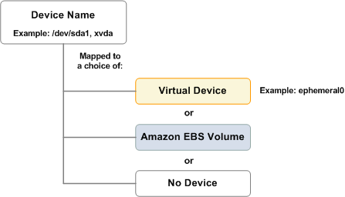
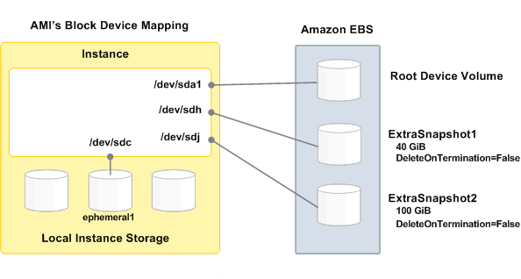
Instance storage?
Notes:
Local instance store only persists during the life of the instance. This is an inexpensive way to launch instances where data is not stored to the root device. For example, some customers use this option to run large web sites where each instance is a clone to handle web traffic.
Usage Scenarios
Instance store volumes are ideal for temporary storage of information that changes frequently, such as buffers, caches, scratch data, and other temporary content, or for data that is replicated across a fleet of instances, such as a load-balanced pool of web servers.
Important Durability Considerations
If an instance reboots (intentionally or unintentionally), the data on the instance store will survive. However, if an underlying drive fails, or if you stop an Amazon EBS-backed instance or terminate instance, the data in the instance store will be lost.

Slide 6
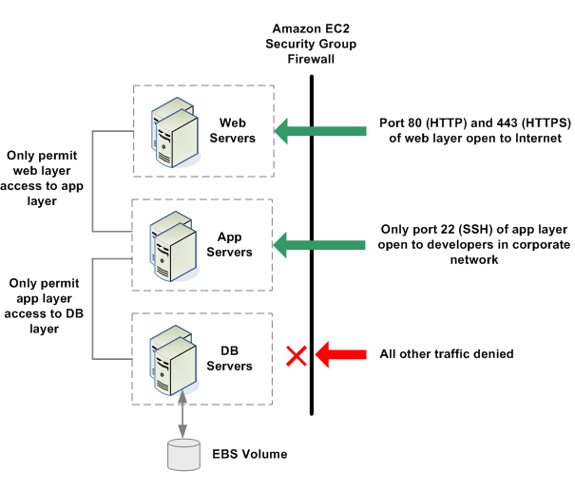
What are security groups?
Notes:
A security group acts as a firewall that controls the traffic allowed into a group of instances. When you launch an Amazon EC2 instance, you can assign it to one or more security groups. For each security group, you add rules that govern the allowed inbound traffic to instances in the group. All other inbound traffic is discarded. You can modify rules for a security group at any time. The new rules are automatically enforced for all existing and future instances in the group.
Assign security groups based on:
IP
Security Group name
Account number/security group name

Slide 7
Amazon EC2 Key Pairs
Amazon EC2 uses public–key cryptography to encrypt and decrypt login information.
Public–key cryptography uses a public key to encrypt a piece of data, such as a password, then the recipient uses the private key to decrypt the data.
The public and private keys are known as a key pair.
The keys that Amazon EC2 uses are 1024-bit SSH-2 RSA keys. You can have up to five thousand key pairs per region.
Notes:
To log in to your instance, you must create a key pair, specify the name of the key pair when you launch the instance, and provide the private key when you connect to the instance. Linux instances have no password, and you use a key pair to log in using SSH.
Amazon EC2 stores the public key only, and you store the private key. Anyone who possesses your private key can decrypt your login information, so it's important that you store your private keys in a secure place.

Slide 8
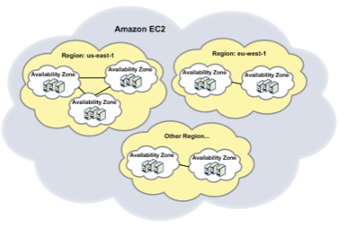
Multiple Locations (Regions)
Asia
AP-SOUTHEAST-1
AP-NORTHEAST-1
AP-SOUTHEAST-2
United States
US-EAST-1
US-WEST-1
US-WEST-2
Europe
EU-WEST-1
EU-CENTRAL-1
South America
SA-EAST-1
Notes:
EC2 is available to use in different Regions. By launching instances in separate Regions, you can design your application to be closer to specific customers or to meet legal or other requirements. Prices for Amazon EC2 usage vary by Region (for more information about pricing by Region, go to the Amazon EC2 Pricing page).
Each Region contains multiple distinct locations called Availability Zones (illustrated in the following diagram). Each Availability Zone is engineered to be isolated from failures in other Availability zones and to provide inexpensive, low-latency network connectivity to other zones in the same Region. By launching instances in separate Availability Zones, you can protect your applications from the failure of a single location.

Slide 9
Regions
US West Region
(Oregon)
Availability Zone A
Availability Zone B
US East Region (N. VA)
GovCloud
Availability Zone A
Availability Zone B
Availability Zone A
Availability Zone B
US West Region
(N. CA)
Availability Zone C
Availability Zone A
Availability Zone B
Conceptual drawing only. The number of Availability Zones may vary
Notes:
Fault Separation
AWS provides customers the flexibility to place instances and store data within multiple geographic Regions. Each Region is an independent collection of AWS resources in a defined geography. AWS currently supports five Regions: US East (Northern Virginia), US West (Northern California), EU (Ireland), Asia Pacific (Singapore) and Asia Pacific (Tokyo). The Amazon S3 US Standard Region includes the US East facilities in Northern Virginia and facilities in Western Washington State.
The selection of a Region within an acceptable geographic jurisdiction to the customer provides a solid foundation to meeting location-dependent privacy and compliance requirements, such as the EU Data Privacy Directive. Data is not replicated between Regions unless proactively done so by the customer, thus allowing customers with these types of data placement and privacy requirements the ability to establish compliant environments. It should be noted that all communications between Regions is across public Internet infrastructure. Appropriate encryption methods should be used to protect sensitive data.
Within a given Region, Amazon EC2, Amazon EBS and Amazon Relational Database Service (RDS) allow customers to place instances and store data across multiple Availability Zones. See the “Business Continuity Management” section for more information on availability.
Amazon S3, Amazon SimpleDB, Amazon Simple Notification Service (SNS), and Amazon Simple Queue Service (SQS) do not expose the concept of Availability Zones to customers. With these services, data is automatically stored on multiple devices across multiple facilities within a Region.
The diagram below demonstrates the Regions and Availability Zones within each Region for Amazon EC2, Amazon EBS and Amazon RDS.

Slide 10
Regions
EU Region (IRE)
EU Region (Frankfurt)
South America
(Sao Paolo)
Availability Zone A
Availability Zone B
Availability Zone A
Availability Zone B
Availability Zone A
Availability Zone B
APAC Region
(Sydney)
APAC Region
(Singapore)
APAC Region
(Tokyo)
Availability Zone A
Availability Zone B
Availability Zone A
Availability Zone B
Availability Zone A
Availability Zone B
Conceptual drawing only. The number of Availability Zones may vary
Notes:
Fault Separation
AWS provides customers the flexibility to place instances and store data within multiple geographic Regions. Each Region is an independent collection of AWS resources in a defined geography.
The selection of a Region within an acceptable geographic jurisdiction to the customer provides a solid foundation to meeting location-dependent privacy and compliance requirements, such as the EU Data Privacy Directive. Data is not replicated between Regions unless proactively done so by the customer, thus allowing customers with these types of data placement and privacy requirements the ability to establish compliant environments. It should be noted that all communications between Regions is across public Internet infrastructure. Appropriate encryption methods should be used to protect sensitive data.

Slide 11
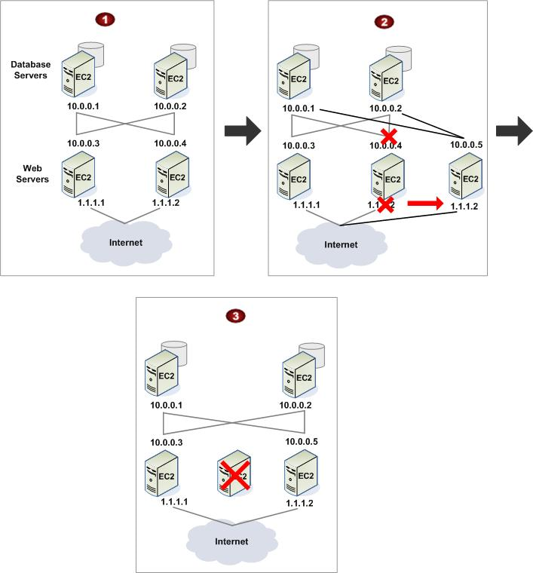
Elastic IPs (EIPs)
Notes:
Elastic IP addresses are static IP addresses designed for dynamic cloud computing. An elastic IP address is associated with your account, not a particular instance. You control addresses associated with your account until you choose to explicitly release them.
In this example:
Web servers are connected to the Internet through Elastic IP addresses (1.1.1.1 and 1.1.1.2) and to database servers through their private IP addresses.
The administrator decides to replace a web server with a larger instance type. To do this, the administrator starts a new instance using a larger instance type, disassociates the 1.1.1.2 Elastic IP address from its running instance, and associates the address with the new instance.
The administrator terminates the old instance.

Slide 12
Instance Types Instance types comprise varying combinations of CPU, memory, storage, and networking capacity and give you the flexibility to choose the appropriate mix of resources for your applications. Each instance type includes one or more instance sizes, allowing you to scale your resources to the requirements of your target workload.
Windows (2008 R1, 2008 R2, 2003)
Linux (Imaged and Custom Kernels)
FreeBSD, Open Solaris
OS
Size
t1,t2,m3, m1, m2, c1,c3,c4,cc1, cg1,r3,g2,i2,hs1
Architecture
x86, 64-bit
Notes:
Micro Instances
Instances of this family provide a small amount of consistent CPU resources and allow you to burst CPU capacity when additional cycles are available. They are well suited for lower throughput applications and web sites that consume significant compute cycles periodically
t1.micro
Standard Instances
Instances of this family are well suited for most applications.
m1.small
m1.large
m1.xlarge
High-Memory Instances
Instances of this family offer large memory sizes for high throughput applications, including database and memory caching applications
m2.xlarge
m2.2xlarge
m2.4xlarge
High-CPU Instances
Instances of this family have proportionally more CPU resources than memory (RAM) and are well suited for compute-intensive applications.
c1.medium
c1.xlarge
Cluster Compute Instances
Instances of this family provide proportionally high CPU resources with increased network performance and are well suited for High Performance Compute (HPC) applications and other demanding network-bound applications.
cC1.4xlarge
Cluster GPU Instances
Instances of this family provide general-purpose graphics processing units (GPUs) with proportionally high CPU and increased network performance for applications benefitting from highly parallelized processing, including HPC, rendering and media processing applications.
cg1.4xlarge

Slide 13
Instance Billing
On-demand
Reserved
Spot
Notes:
On-Demand
On-Demand Instances let you pay for compute capacity by the hour with no long-term commitments. This frees you from the costs and complexities of planning, purchasing, and maintaining hardware and transforms what are commonly large fixed costs into much smaller variable costs.
Reserved
Reserved Instances give you the option to make a low, one-time payment for each instance you want to reserve and in turn receive a significant discount on the hourly usage charge for that instance. After the one-time payment for an instance, that instance is reserved for you, and you have no further obligation; you may choose to run that instance for the discounted usage rate for the duration of your term, or when you do not use the instance, you will not pay usage charges on it.
Spot
Spot Instances enable you to bid for unused Amazon EC2 capacity. Instances are charged the Spot Price, which is set by Amazon EC2 and fluctuates periodically depending on the supply of and demand for Spot Instance capacity. To use Spot Instances, you place a Spot Instance request, specifying the instance type, the Availability Zone desired, the number of Spot Instances you want to run, and the maximum price you are willing to pay per instance hour. To determine how that maximum price compares to past Spot Prices, the Spot Price history is available via the Amazon EC2 API and the AWS Management Console. If your maximum price bid exceeds the current Spot Price, your request is fulfilled and your instances will run until either you choose to terminate them or the Spot Price increases above your maximum price (whichever is sooner).
Dedicated
Dedicated Instances are Amazon EC2 instances launched within your Amazon Virtual Private Cloud (Amazon VPC) that run hardware dedicated to a single customer. Dedicated Instances let you take full advantage of the benefits of Amazon VPC and the AWS cloud – on-demand elastic provisioning, pay only for what you use, and a private, isolated virtual network, all while ensuring that your Amazon EC2 compute instances will be isolated at the hardware level.
You can easily create a VPC that contains dedicated instances only, providing physical isolation for all Amazon EC2 compute instances launched into that VPC, or you can choose to mix both dedicated instances and non-dedicated instances within the same VPC based on application-specific requirements. Click here for additional instructions on launching Dedicated Instances.

Slide 14
Instance Billing
On-demand | Reserved | Spot
Pay for compute capacity by the hour
No long-term commitments
Transform large fixed costs into much smaller variable costs
Notes:
On-Demand
On-Demand Instances let you pay for compute capacity by the hour with no long-term commitments. This frees you from the costs and complexities of planning, purchasing, and maintaining hardware and transforms what are commonly large fixed costs into much smaller variable costs.
Reserved
Reserved Instances give you the option to make a low, one-time payment for each instance you want to reserve and in turn receive a significant discount on the hourly usage charge for that instance. After the one-time payment for an instance, that instance is reserved for you, and you have no further obligation; you may choose to run that instance for the discounted usage rate for the duration of your term, or when you do not use the instance, you will not pay usage charges on it.
Spot
Spot Instances enable you to bid for unused Amazon EC2 capacity. Instances are charged the Spot Price, which is set by Amazon EC2 and fluctuates periodically depending on the supply of and demand for Spot Instance capacity. To use Spot Instances, you place a Spot Instance request, specifying the instance type, the Availability Zone desired, the number of Spot Instances you want to run, and the maximum price you are willing to pay per instance hour. To determine how that maximum price compares to past Spot Prices, the Spot Price history is available via the Amazon EC2 API and the AWS Management Console. If your maximum price bid exceeds the current Spot Price, your request is fulfilled and your instances will run until either you choose to terminate them or the Spot Price increases above your maximum price (whichever is sooner).
Dedicated
Dedicated Instances are Amazon EC2 instances launched within your Amazon Virtual Private Cloud (Amazon VPC) that run hardware dedicated to a single customer. Dedicated Instances let you take full advantage of the benefits of Amazon VPC and the AWS cloud – on-demand elastic provisioning, pay only for what you use, and a private, isolated virtual network, all while ensuring that your Amazon EC2 compute instances will be isolated at the hardware level.
You can easily create a VPC that contains dedicated instances only, providing physical isolation for all Amazon EC2 compute instances launched into that VPC, or you can choose to mix both dedicated instances and non-dedicated instances within the same VPC based on application-specific requirements. Click here for additional instructions on launching Dedicated Instances.

Slide 15
Instance Billing
On-demand | Reserved | Spot
Make a low, one-time payment for each instance
Receive significant discount on the hourly usage charge for that instance
After one-time payment, instance is reserved for you
No further obligation: run instance at discounted rate, or turn off and pay no usage charge
Notes:
On-Demand
On-Demand Instances let you pay for compute capacity by the hour with no long-term commitments. This frees you from the costs and complexities of planning, purchasing, and maintaining hardware and transforms what are commonly large fixed costs into much smaller variable costs.
Reserved
Reserved Instances give you the option to make a low, one-time payment for each instance you want to reserve and in turn receive a significant discount on the hourly usage charge for that instance. After the one-time payment for an instance, that instance is reserved for you, and you have no further obligation; you may choose to run that instance for the discounted usage rate for the duration of your term, or when you do not use the instance, you will not pay usage charges on it.
Spot
Spot Instances enable you to bid for unused Amazon EC2 capacity. Instances are charged the Spot Price, which is set by Amazon EC2 and fluctuates periodically depending on the supply of and demand for Spot Instance capacity. To use Spot Instances, you place a Spot Instance request, specifying the instance type, the Availability Zone desired, the number of Spot Instances you want to run, and the maximum price you are willing to pay per instance hour. To determine how that maximum price compares to past Spot Prices, the Spot Price history is available via the Amazon EC2 API and the AWS Management Console. If your maximum price bid exceeds the current Spot Price, your request is fulfilled and your instances will run until either you choose to terminate them or the Spot Price increases above your maximum price (whichever is sooner).
Dedicated
Dedicated Instances are Amazon EC2 instances launched within your Amazon Virtual Private Cloud (Amazon VPC) that run hardware dedicated to a single customer. Dedicated Instances let you take full advantage of the benefits of Amazon VPC and the AWS cloud – on-demand elastic provisioning, pay only for what you use, and a private, isolated virtual network, all while ensuring that your Amazon EC2 compute instances will be isolated at the hardware level.
You can easily create a VPC that contains dedicated instances only, providing physical isolation for all Amazon EC2 compute instances launched into that VPC, or you can choose to mix both dedicated instances and non-dedicated instances within the same VPC based on application-specific requirements. Click here for additional instructions on launching Dedicated Instances.

Slide 16
Instance Billing
On-demand | Reserved | Spot
Bid for unused Amazon EC2 capacity
Prices set by Amazon EC2 and fluctuates with supply and demand
To use, place a Spot request: specify instance type, availability zone, number of instances, and maximum price/hour you are willing to pay
AWS can terminate Spot Instances without notice
Default max = 100 instances (instead of 20 On-demand)
Notes:
On-Demand
On-Demand Instances let you pay for compute capacity by the hour with no long-term commitments. This frees you from the costs and complexities of planning, purchasing, and maintaining hardware and transforms what are commonly large fixed costs into much smaller variable costs.
Reserved
Reserved Instances give you the option to make a low, one-time payment for each instance you want to reserve and in turn receive a significant discount on the hourly usage charge for that instance. After the one-time payment for an instance, that instance is reserved for you, and you have no further obligation; you may choose to run that instance for the discounted usage rate for the duration of your term, or when you do not use the instance, you will not pay usage charges on it.
Spot
Spot Instances enable you to bid for unused Amazon EC2 capacity. Instances are charged the Spot Price, which is set by Amazon EC2 and fluctuates periodically depending on the supply of and demand for Spot Instance capacity. To use Spot Instances, you place a Spot Instance request, specifying the instance type, the Availability Zone desired, the number of Spot Instances you want to run, and the maximum price you are willing to pay per instance hour. To determine how that maximum price compares to past Spot Prices, the Spot Price history is available via the Amazon EC2 API and the AWS Management Console. If your maximum price bid exceeds the current Spot Price, your request is fulfilled and your instances will run until either you choose to terminate them or the Spot Price increases above your maximum price (whichever is sooner).

Slide 17
For more information about Amazon Elastic Compute Cloud…
http://aws.amazon.com/ec2/
THANK YOU

